Slide 1



Anti-Theft System for Automobile
Benha University
Faculty of Engineering at Shoubra
Computer Systems Engineering
Graduation Project I (CCE580)
Using Concepts of Embedded Systems and AUTOSAR Standards

Slide 2

Team Members:
Abdelaziz Abu Zaid Mohamed Ismail
Hazem Youssri Gamal Asqalany
Mourad Eldin Nash’at Mourad Muhammed
Youssef Mamdouh Mohamed El-Nemaky (Team Leader)
Supervised by:
Dr. May Mohamed
Supported by:
Special thanks to Tech lead Eng. Abdelrahman Mabrouk

Slide 3

Introduction

Slide 4
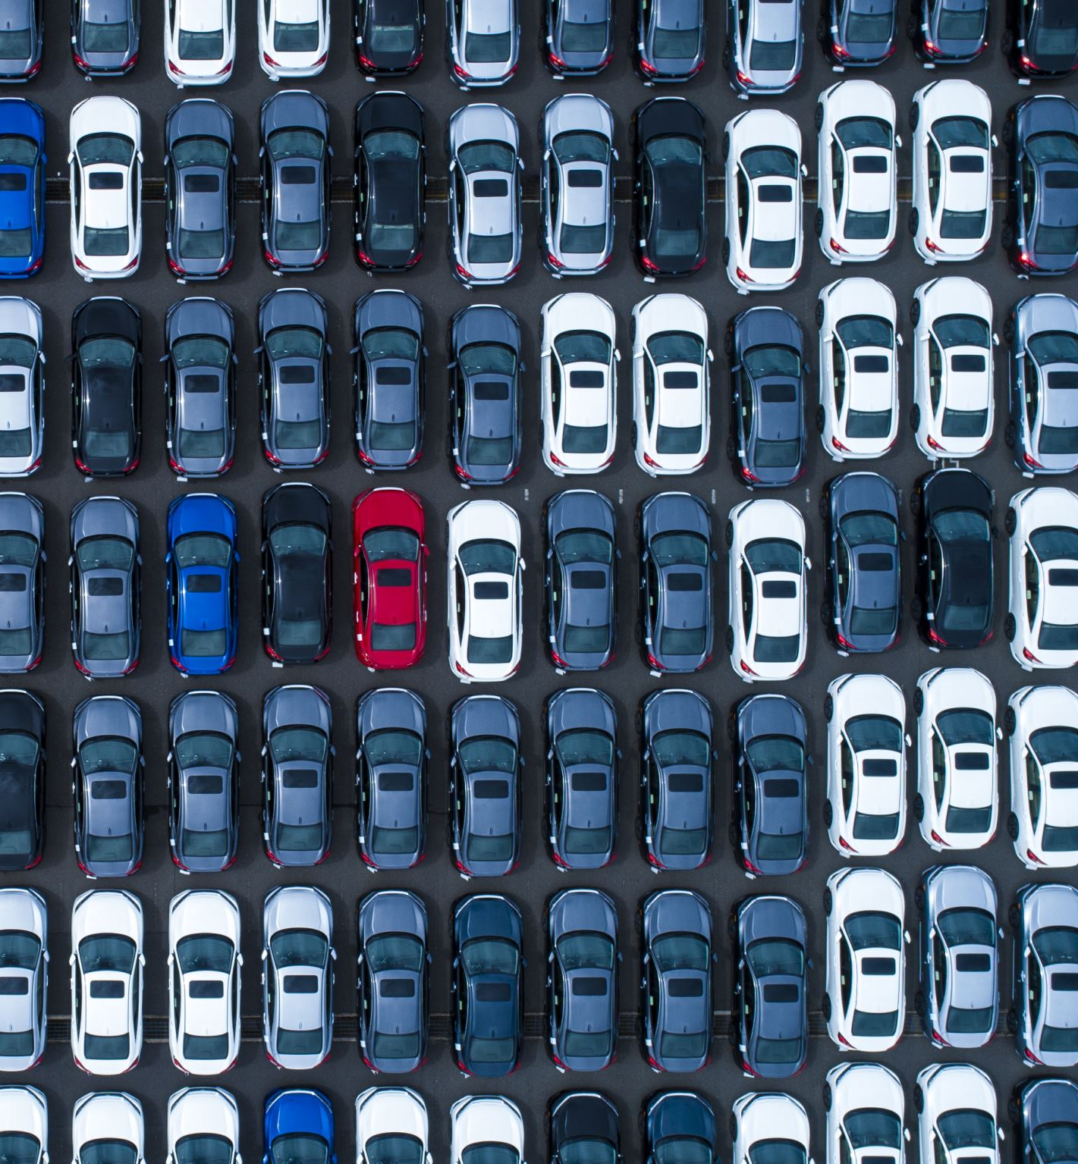
Introduction:
Car Thievery is a Problem That always should be in mind and security measures should be updated from time to time to maintain the vehicle’s safety. There are many people who tried to solve this by applying certain methods and techniques to prevent car thievery by implementing some Security Systems.

Slide 5
Problem Statement:
According to studies the average value for Egypt during the period from 2003 to 2011 was 64 thefts per 100,000 people with a minimum of 42 thefts per 100,000 people in 2003 and a maximum of 104 thefts per 100,000 people in 2011. The latest value from 2011 is 104 thefts per 100,000 people. One car stolen in a thousand doesn’t seem much, now imagine that car is yours!

Slide 6
Number of Stolen Cars in each year:

Slide 7
Number of Stolen Vehicles in each year:

Slide 8
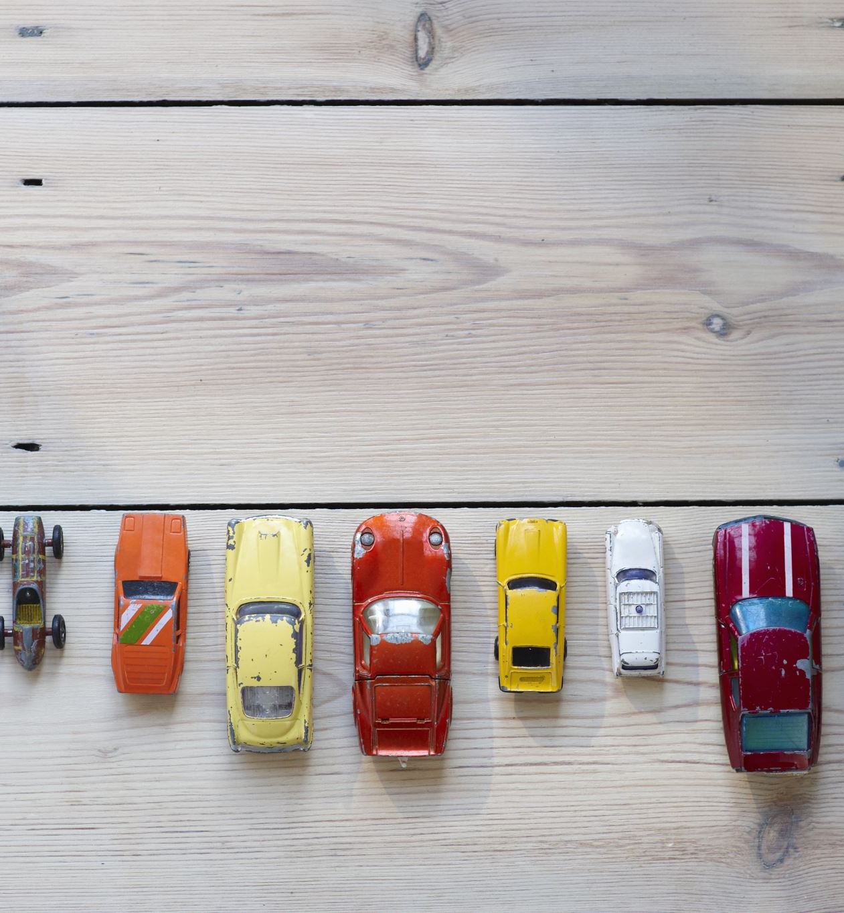
Motivation:
Most of the efforts are exerted on high end vehicles, while most of the car owners own mid to low end automobiles.
We, a group of students, wished to develop a security system that works on most vehicles mostly mid to low end automobiles.

Slide 9

Some Previous Implementations

Slide 10
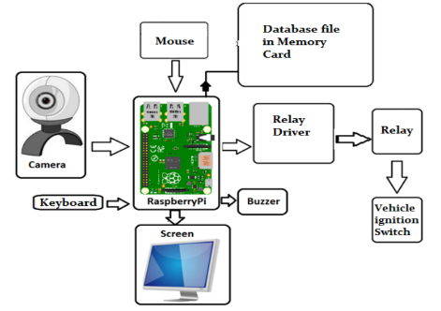
Implementation 1: FACE RECOGNITION BASED INTELLIGENT CAR ANTI-THEFT SYSTEM USING RASPBERRY PI (2021)
Technology:
Face Recognition.
Strengths:
Facial Recognition.
Uses Malware Detection.
Weaknesses:
Facial recognition can be tricked in some instances with high resolution copies of owner

Slide 11
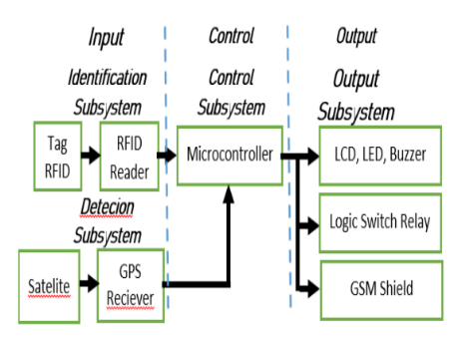
Implementation 2: Microcontroller-based RFID, GSM and GPS for Motorcycle Security System (2019)
Technology:
RFID, GPS and GSM
Strengths:
Immediate notification of user.
Tracking information which can be used to locate vehicle.
Weaknesses:
Subject to GSM jamming.
Subject to GPS spoofing.

Slide 12
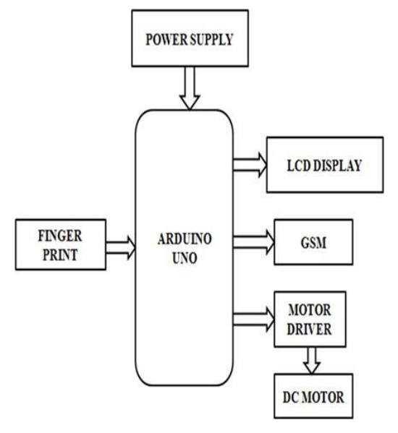
Implementation 3: Fingerprint based Anti Theft for Two Wheelers Authentication of Vehicle users (2020)
Technology:
Biometrics (Fingerprint)
Strengths:
Biometrics enhance the traditional security.
Password provides contingency.
Weaknesses:
Possibly susceptible to fingerprint spoofing
Access to password by attacker will enable biometrics bypass.

Slide 13
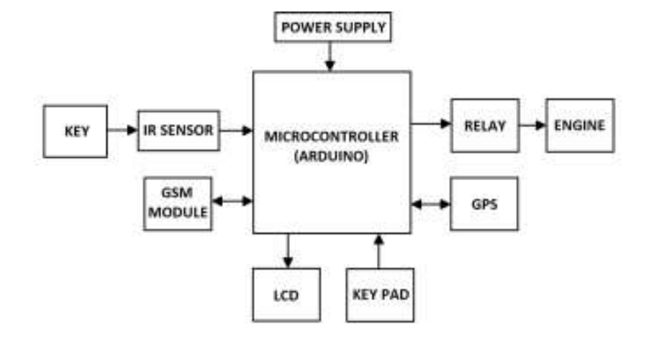
Implementation 4: Anti-Theft Security System for Vehicles (2018)
Technology:
Keypad, GPS and GSM
Strengths:
Provides tracking capabilities.
Weaknesses:
Security can be bypassed with just a key.

Slide 14

Our Proposed System

Slide 15
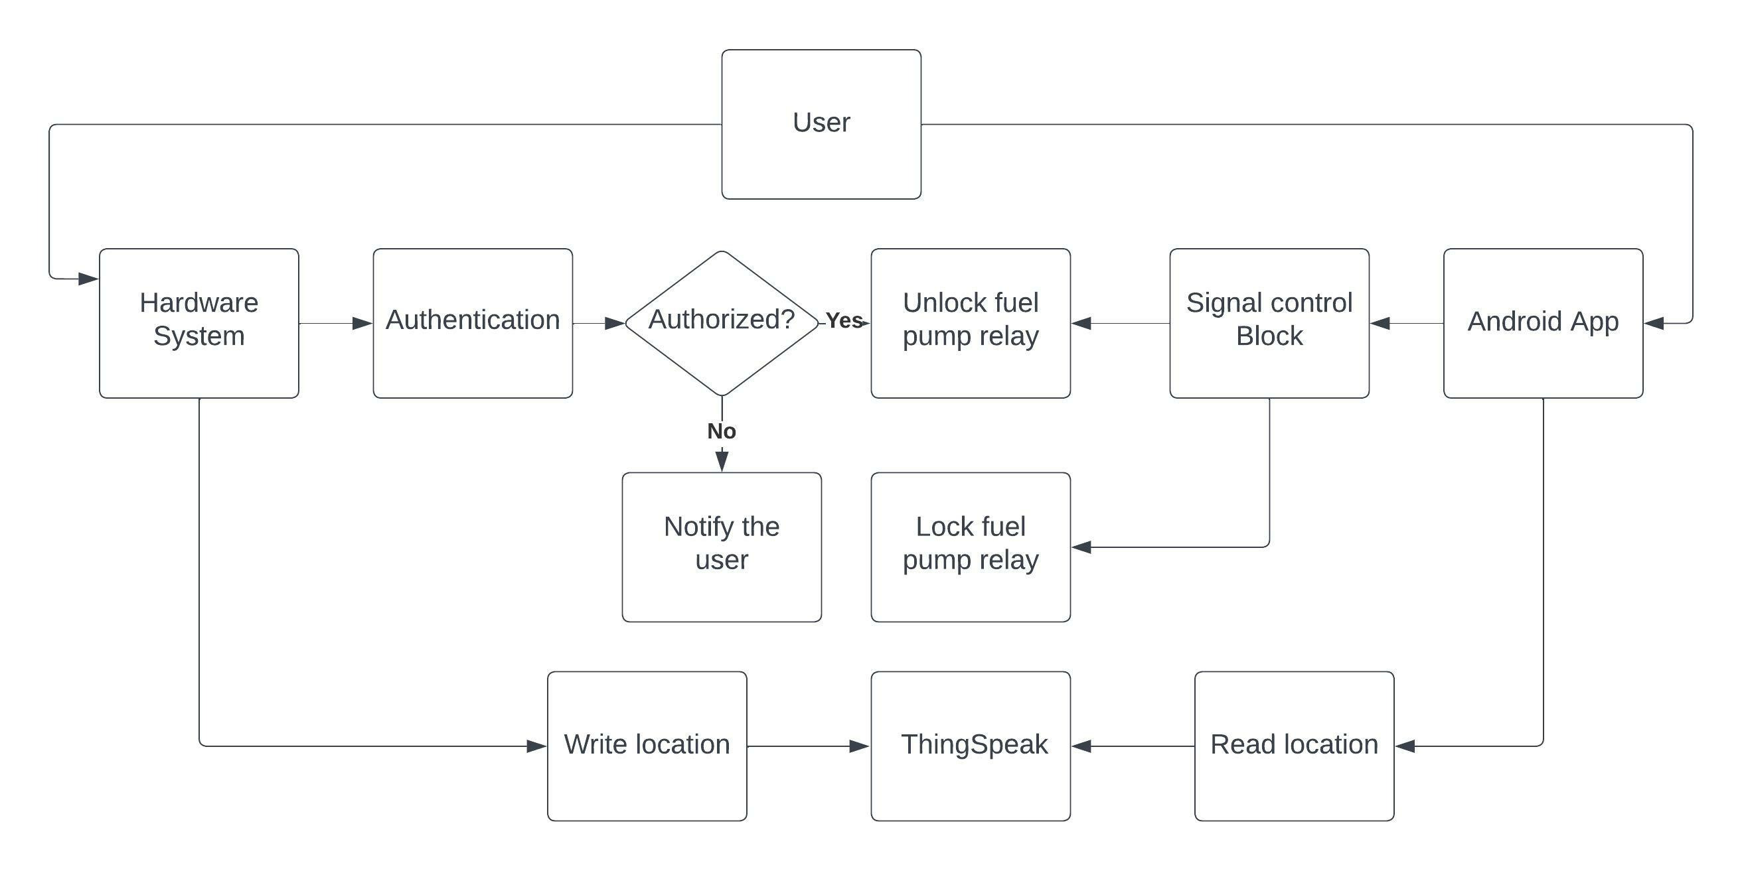
Overview of our System:

Slide 16
Our System is Built using Three Concepts:
Embedded System (Most Part)
Face Recognition
Mobile Application (Android)

Slide 17

Embedded System

Slide 18
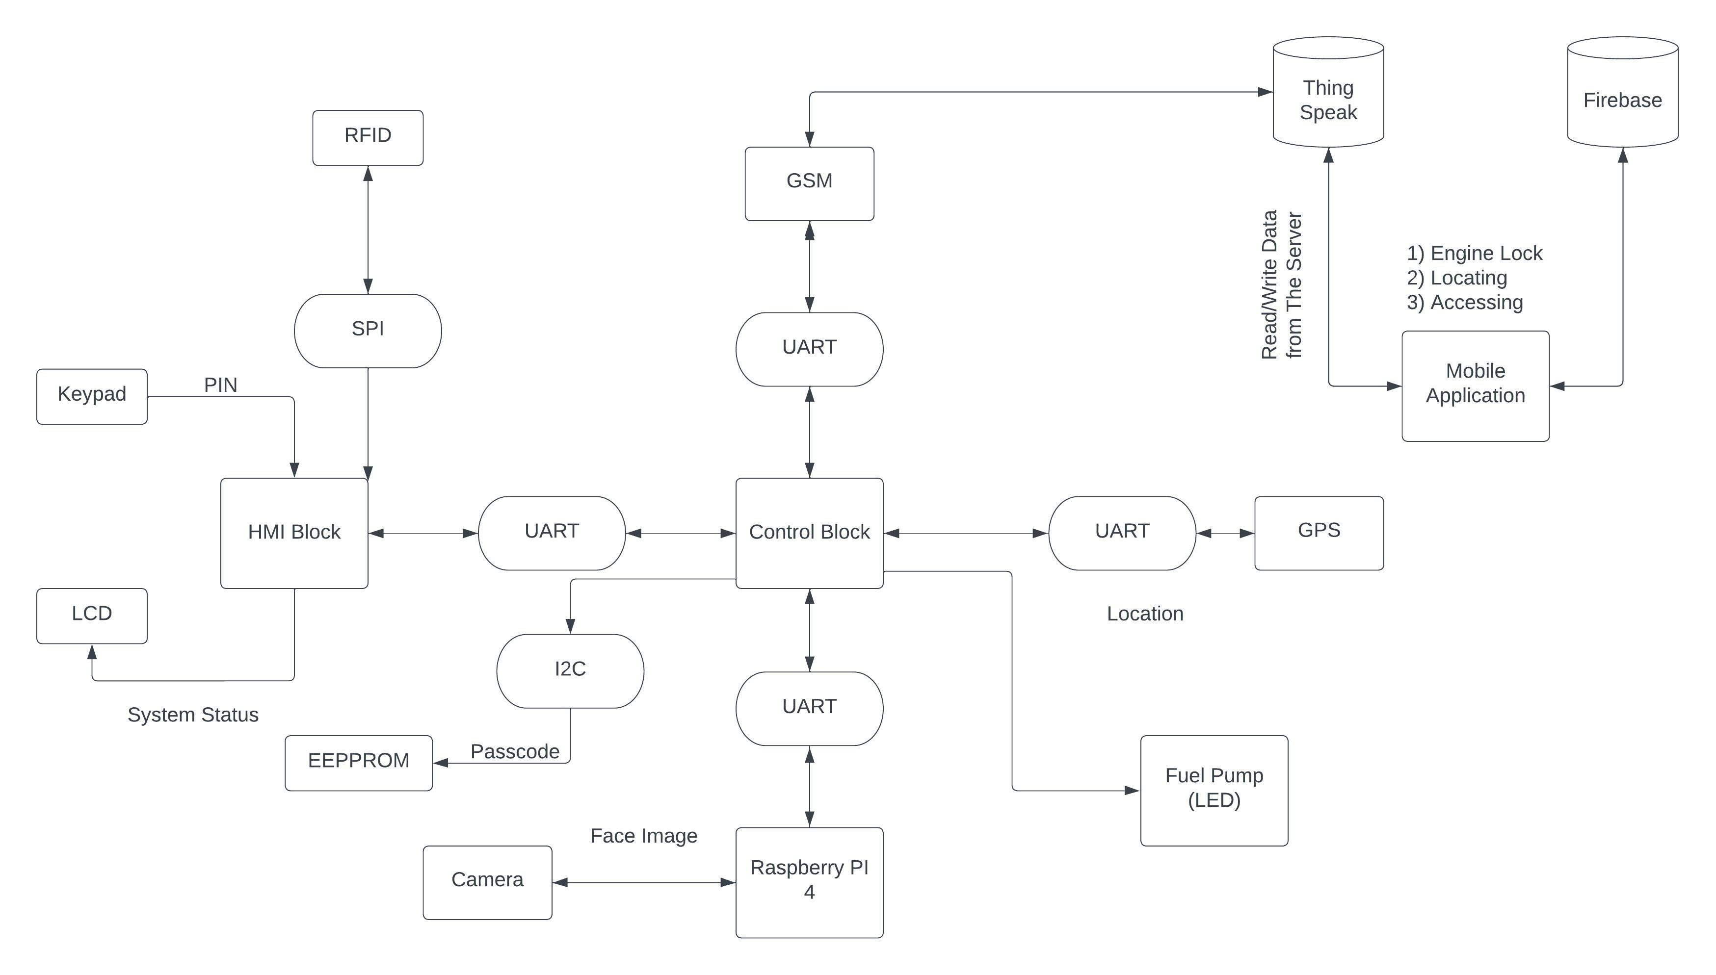
Block Diagram:

Slide 19
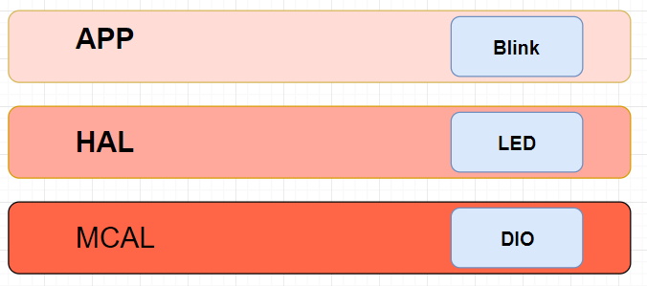
Layering Model in Embedded Applications:

Slide 20
Used Software Drivers:
MCAL | HAL
PORT (AUTOSAR) | LCD
DIO (AUTOSAR) | Keypad
UART | RFID
Timer | GSM Module
External Interrupt | GPS Module
SPI | External EEPROM
I2C

Slide 21
Used Hardware & Software Components:
Hardware | Software
Tiva C (TM4C123GH6PM) | Eclipse IDE
Raspberry Pi 4 (Model B 8GB RAM) | Visual Studio Code
Raspberry Pi Camera Module 2 Noir | IAR Embedded Workbench
RFID Module (RC522) | Android Studio
GPS/GSM Module (SIM808) | Git
LCD (4X20) | Altium Designer
KEYPAD (4X4)
EEPROM (24C16)

Slide 22
Control Block:
This is the brain of our system where all decisions and calculations are done.
A Tiva C connected with Raspberry Pi , GPS/GSM Module and the Fuel pump Relay.
The Control Block is also connected to HMI Block via UART.

Slide 23
Control Block:
This block communicates with the user remotely using The GSM Module.
It also communicates with Raspberry using UART Communication Protocol.

Slide 24
Control Block Inputs & Outputs :
Inputs | Outputs
Receives signal from HMI to start setup process | Uploads the data to the server using GSM module
Receives password from HMI | Send SMS to the user’s Mobile
Receives authentication result from raspberry pi | Stop/Start fuel pump relay.
Receives commands from the mobile application through GSM module | Sends signal to the raspberry pi to start face recognition process
Receives RFID Tag from HMI | Sends system status to HMI to display it on the LCD

Slide 25
HMI Block:
As the name sounds this block is what the user interacts with.
This is a Tiva C board connected to:
RFID Module
Keypad
LCD
The HMI is connected to the Control Block via UART

Slide 26
HMI Block:
The LCD and Keypad are used to communicate with the user
The RFID is used only during authentication process (RFID Tag Scan)

Slide 27
HMI Block Inputs & Outputs:
Inputs | Outputs
Reads password from the user | Sends the password to control block to check for authentication
Receives system status from control block | Displays system status on LCD
Scan RFID Tag from the user | Send RFID Tag to the control Block

Slide 28
Raspberry Pi Block:
Raspberry Pi 4 model B is connected to the Control Block using UART.
With the camera connected to it, this block is only used during authentication process (Face Recognition).
We used Raspberry Pi as its a powerful hardware which minimizes face recognition time.

Slide 29
Raspberry Pi Block Inputs & Outputs :
Inputs | Outputs
Receives authentication command from Control Block | Send the authentication result back to Control block
Receives visuals from camera

Slide 30
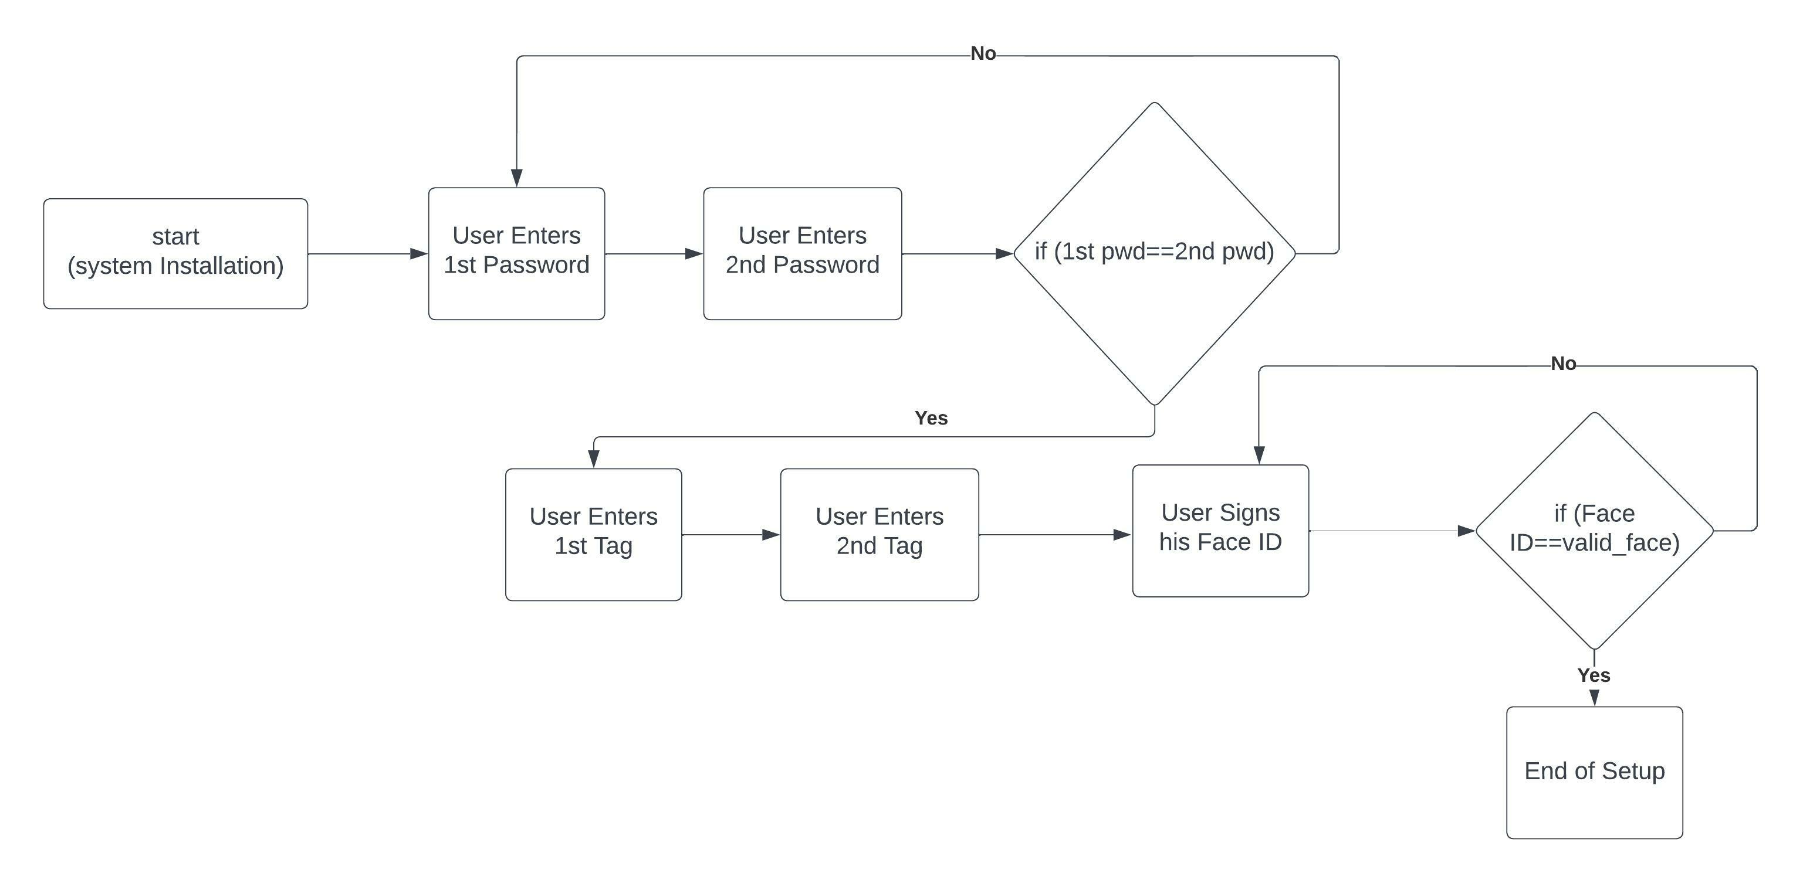
Fist Time Setup process:

Slide 31
Fist Time Setup process:
After installing the system in the vehicle, the user setups their credentials (passcode, RFID and Face ID).
Passcode is entered twice for confirmation.
2 RFID tags are scanned.
Face ID is then added (3 photos are taken).

Slide 32
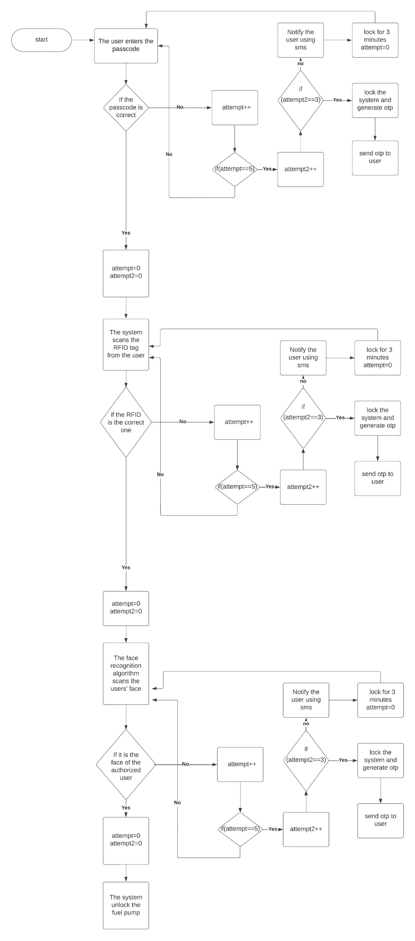
Authentication process (Passcode):

Slide 33
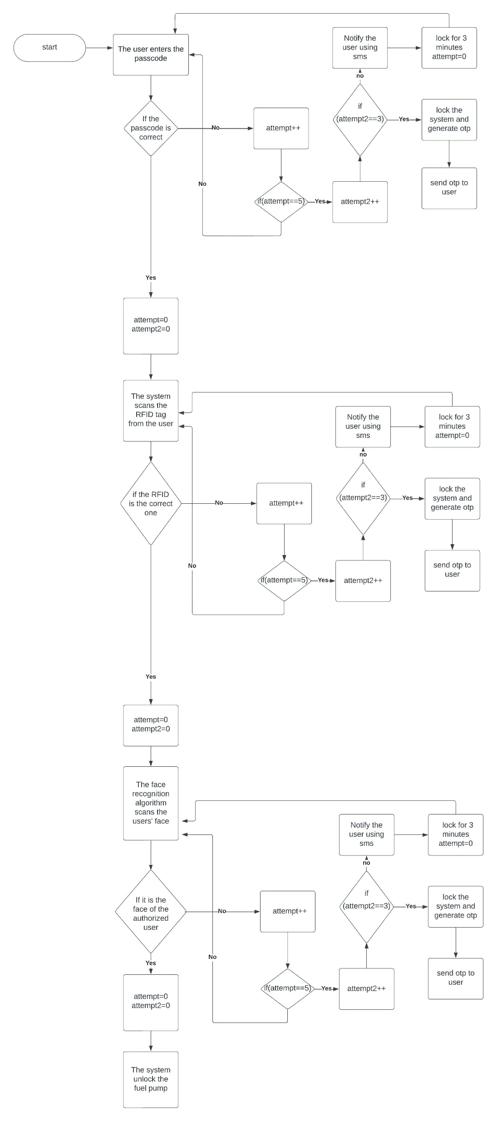
Authentication process (RFID):

Slide 34
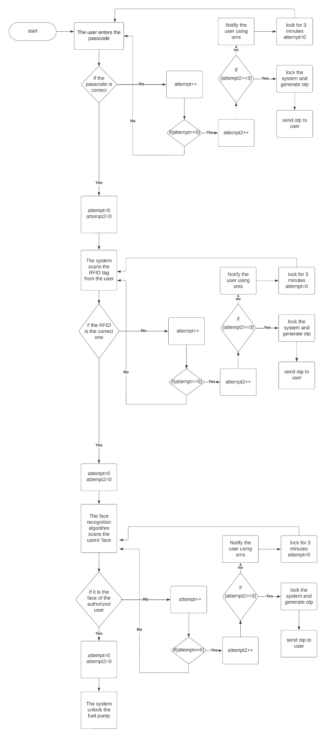
Authentication process (Face ID)

Slide 35
Authentication Process:
If the user now wants to use their vehicle, they have to go through this process.
The user now is to enter their passcode.
RFID tag scan comes after that.
And lastly, Face recognition.

Slide 36
Authentication Process:
If the user is authorized the fuel pump is unlocked and they can start the engine.
If the user fails the authentication 5 times in a row The Hardware notifies the owner of an access and locks the system for 3 minutes.
If the user fails the authentication 15 times in a row The system is locked and sends an OTP to the owner, which is used to unlock the system.

Slide 37
Fuel Pump:
After a valid authentication, the fuel pump relay is unlocked, while an invalid one keeps it locked (obviously).
When the user starts the engine, a signal is input to the hardware which indicates the engine status.
When the user turns off the engine a timer is set to 5 minutes. During this time, no reauthentication is required.
After the 5 minutes the fuel pump relay is turned off.

Slide 38

Face Recognition

Slide 39
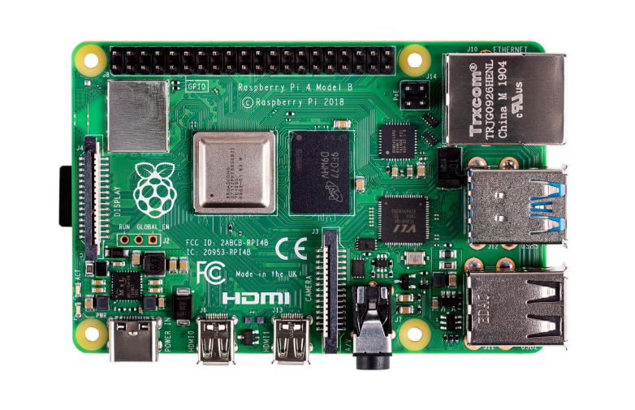
Face Recognition:
Using The Raspberry Pi 4 Model B.
A CNN Algorithm written in Python should do the matching and recognition

Slide 40
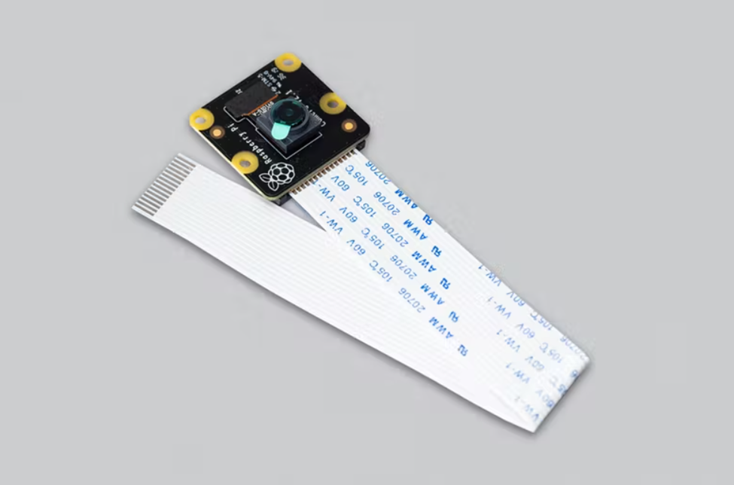
Face Recognition:
The Pictures is fed to the Raspberry pi Through the Raspberry Pi Camera.

Slide 41
Face Recognition:
The Camera Takes 3 Pictures during the setup process.
The pictures are used to identify the user during the authentication phase.

Slide 42

Mobile Application

Slide 43
Mobile Application:
This is the what the user uses to remotely interact with the system.
The application communicates with the Control Block.
The user is required to create an account to use the application.

Slide 44
Mobile Application:
The user can use the application to:
Locate the vehicle.
Turn ON/OFF the vehicle’s engine Remotely.

Slide 45
Locate the vehicle:
The hardware updates the location automatically every 5 minutes.
The location is written on ThingSpeak (an online server).
The Android Application can be used to read that location.
A third-party app is used to view the location. i.e., Maps.

Slide 46
Remote Fuel Pump control:
The Application can send codes to the Hardware to control the Fuel Pump (Engine Lock / Unlock)
The hardware intercepts the signal using GSM module.
Depending on the contents of the message sent, the pump is either turned ON/OFF.

Slide 47

Results and Discussions

Slide 48
Results and Discussions:
Unfortunately, we were not able to test our system on a real car.
So, we tested the system on simple LEDs and buzzers as to verify the desired results.

Slide 49
Real Time data:
Process | Time (seconds) (Min to Max)
Sending SMS from hardware to mobile | 2 to 5 secs
Receiving SMS from mobile to hardware | 3 to 6 secs
Face Capture | 3 to 4 secs
Face Recognition | 3 to 5 secs

Slide 50

Conclusion

Slide 51
Conclusion
After integrating all the parts of software and hardware, we managed to achieve a decent degree of security to ensure that the vehicle will not be stolen.
Using a three-way authentication system ensures only the authorized users will be able to unlock the engine.

Slide 52
Conclusion
The only requirement is that the vehicle has a fuel pump, which is found in all vehicles that runs on fuel.
This targets low end automobiles as well as newer ones.

Slide 53
Future Work:
Track the location of the vehicle instead of simply locating it.
Increase the users’ degree of controlling the system.
The system could use a close-range (Bluetooth) detector to wake the system when the user approaches to the vehicle.

Slide 54
Future Work:
Add a rechargeable battery, which charges itself when the vehicle is on the move using the vehicle’s battery.
Add deep learning algorithms, so that it can gather enough data of the user and use that data to facilitate the authentication process.
Optimize power consumption with sleep mode

Slide 55

Thank You

